Slide 1

ECOfluid/NORAM WW TREATMENT OVERVIEW
WHO AM I
ECOFLUID ABBREVIATED HISTORY
USBF FOOTPRINT
USBF APPLICATIONS
ECOFLUID CAPABILITIES
EXISTING PROJECTS
NORAM WASTEWATER – VERTREAT AND BEYOND
CAPABILITIES
SALES AND MARKETING

Slide 2
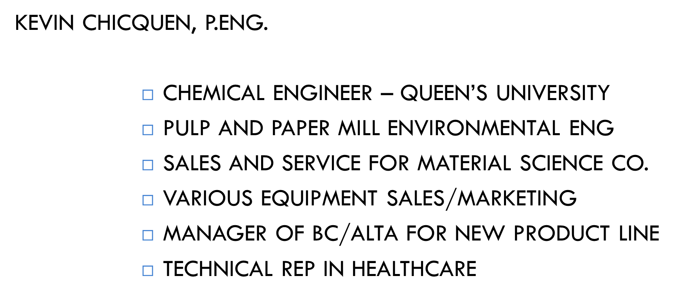

Slide 3
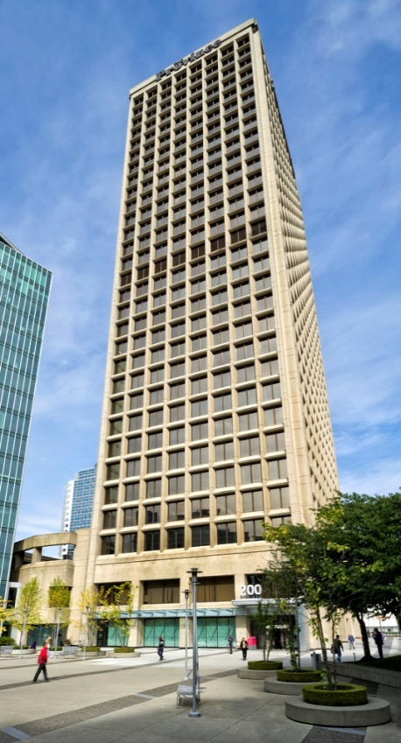
About ECOfluid
Our interdisciplinary team of wastewater engineers, designers, operators and business specialists, provide clients with extensive and well-rounded industry knowledge and experience
Established in 1995 in Vancouver, BC as a provider of complete wastewater treatment solutions, introducing the USBF process
  Over 200 installations across North America and the Caribbean
  Process Design l Equipment Supply l Design-Build
Full contract O&M services division launched in 1998
  Close and immediate feedback between designers and operators
  Facilitates continuous improvement of technologies and processes
In 2012, ECOfluid was acquired by NORAM Engineering and Constructors Ltd., a worldwide leader in the fields of nitration, sulphuric acid and electrochemistry
  Provides strong technical and financial backing
  The group also includes BC Research and Axton Inc.

Slide 4
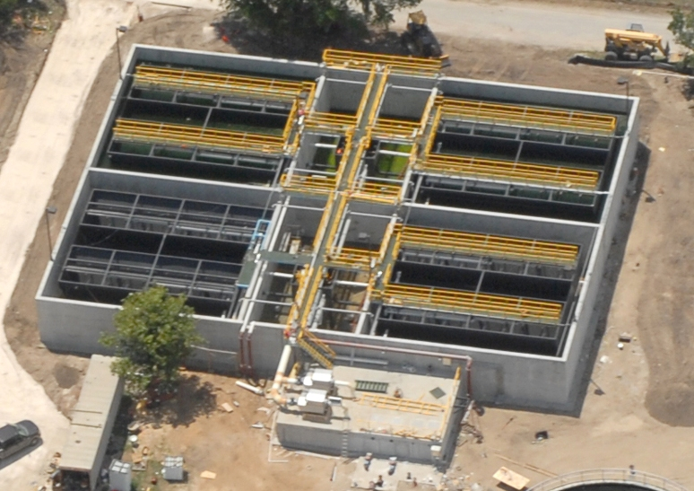
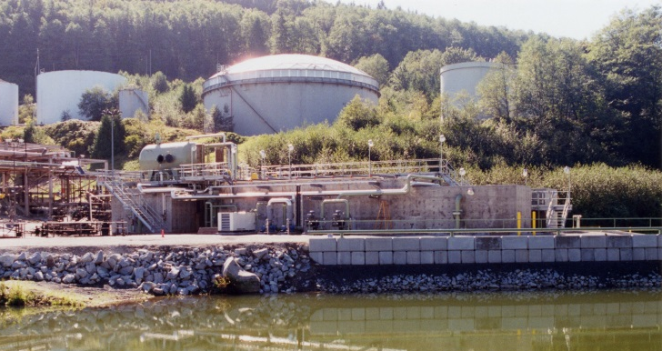
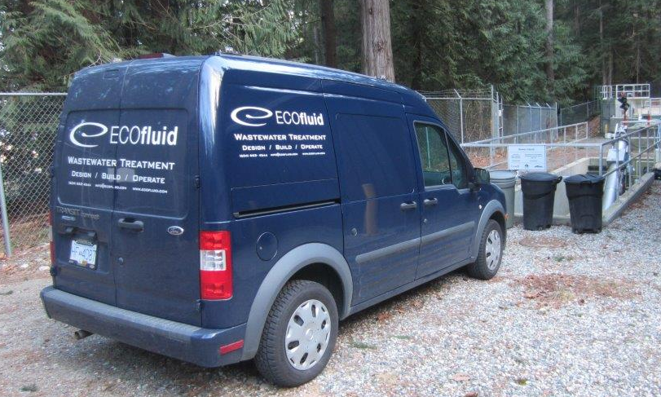
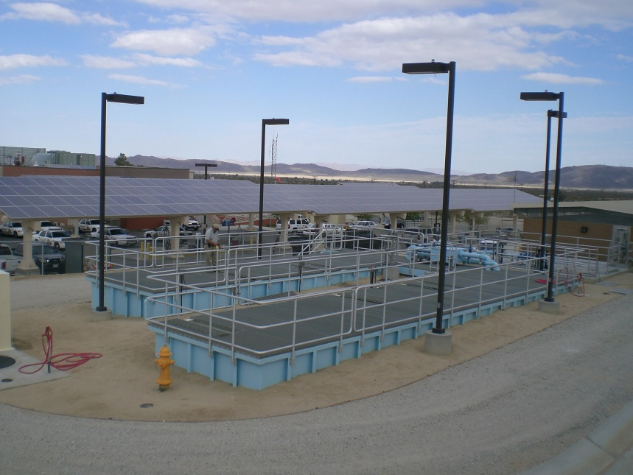

ECOfluid Systems Inc.
Tel: (604) 662-4544
Email: info@ECOfluid.com
Industrial WWTPs
Site constructed municipal WWTPs
Operation & Maintenance
Containerized & skid-mounted systems
Factory-built
package plants
Complete Wastewater Solutions

Slide 5
About ECOfluid
Services
Process Design
Equipment Supply
Applications
Municipal Wastewater Treatment
Industrial Wastewater Treatment
Design-Build
Operation & Maintenance
Research & Development
Packaged & Containerized Wastewater Systems
Clients
Private Developers
Municipalities
General Contractors
Industrial Firms

Slide 6
About ECOfluid
Pre-Treatment / Headworks Systems
Biological Treatment Processes
• USBF®
• MBR
• MBBR/IFAS
• VERTREAT™ (NORAM)
Tertiary Treatment Processes
Sludge Dewatering & Processing Systems
Complete Wastewater Solutions

Slide 7
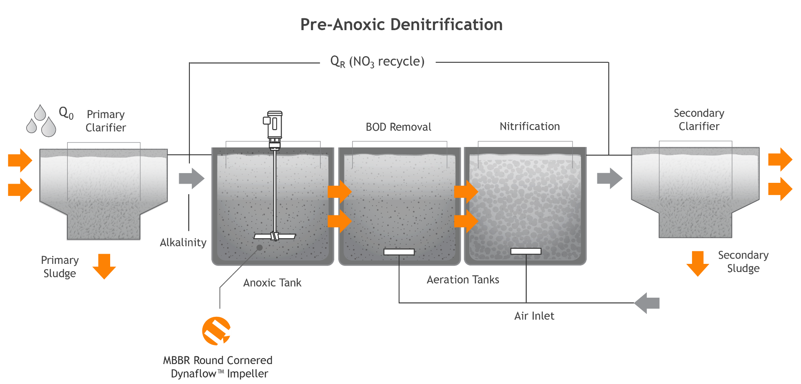
SECONDARY WW TREATMENT PLANT

Slide 8
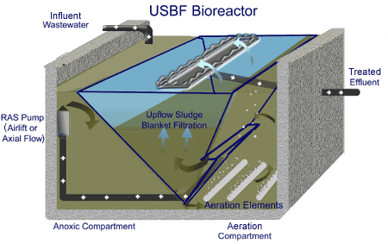
Treatment Processes
USBF
Simple process
Gravity flow through
No moving parts
Hydraulically self-regulating

Slide 9
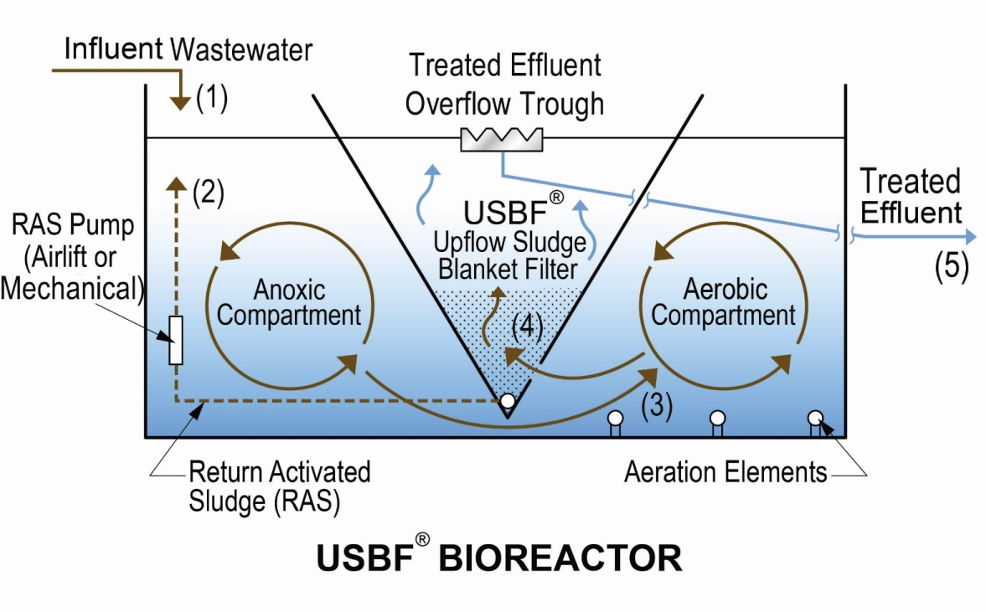
Treatment Processes
USBF
USBF® is an integrated bioreactor that incorporates anoxic and aerobic compartments plus upflow filtration
        Benefits
        effective treatment w/ nitrogen
        removal
        gravity flow-through, simple
        operation
        compact and robust
        modular and expandable
        fluidized bed filtration efficiency
        self-regulating hydraulic flexibility
ECOfluid patented process
Influent enters anoxic compartment
Influent and RAS mix
Flows into aerobic compartment
Enters bottom of Sludge Blanket Filter
Effluent collected in trough; gravity discharge (to disposal or post-treatment)

Slide 10

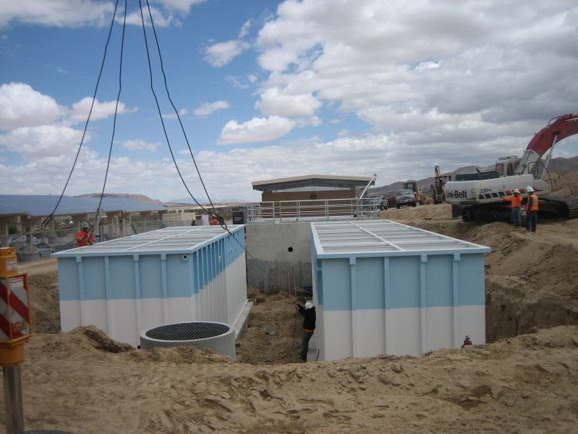
Project Profile
Joshua Basin WWTP, California
Project: Hospital
Start-up: 2013
Size: 280 m³/d (75,000 GPD)
Process: USBF®
Contract: Design-Supply
Key objectives:
  enhanced nitrogen reduction
  odor and noise abatement
  package plant
  remote supervision capability

Slide 11
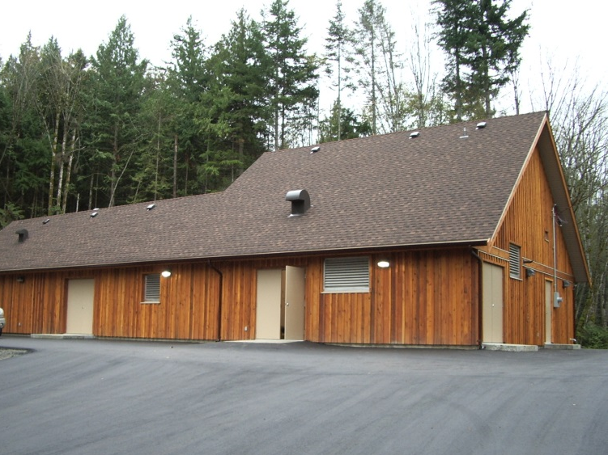
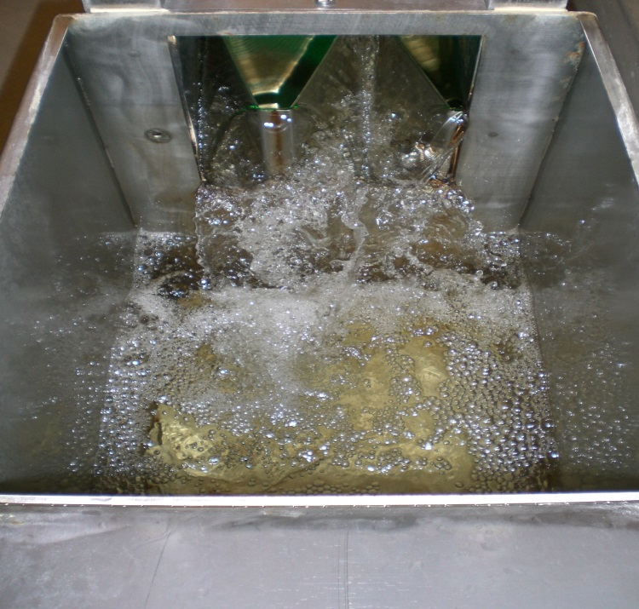
Project Profile
Nanoose First Nation WWTP, British Columbia
Project: First Nation Community
Start-up: 2006
Size: 120 m³/d (30,000 GPD)
Process: USBF®
Contract: Design-Supply-Install-O&M
Key objectives:
  odor and noise abatement
  good neighbor (hidden, unobtrusive, no visual impact)
  environmentally sensitive discharge
  modular and expandable
  architectural integration
  local O&M with remote supervision

Slide 12
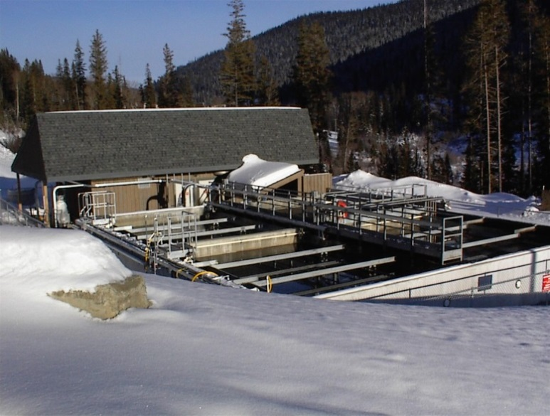
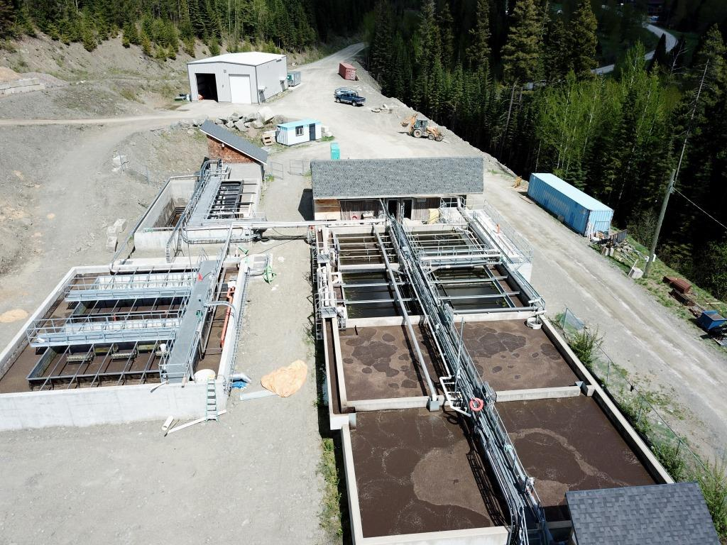
Project Profile
Sun Peaks Resort WWTP, British Columbia
Project: Ski Resort
Start-up: 1999 (exp. 2003/08/17)
Size: 1,500 m³/d (400,000 GPD)
Process: USBF®
Contract: Design-Supply-Install
Key objectives:
  cold weather operation
  high seasonal and weekend flows and loadings
  modular and expandable
Plant 1999 above and 2019 below

Slide 13
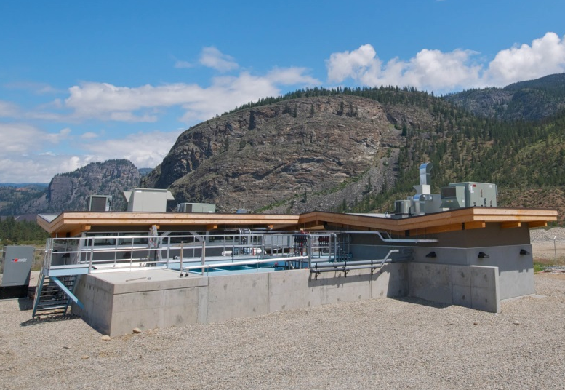
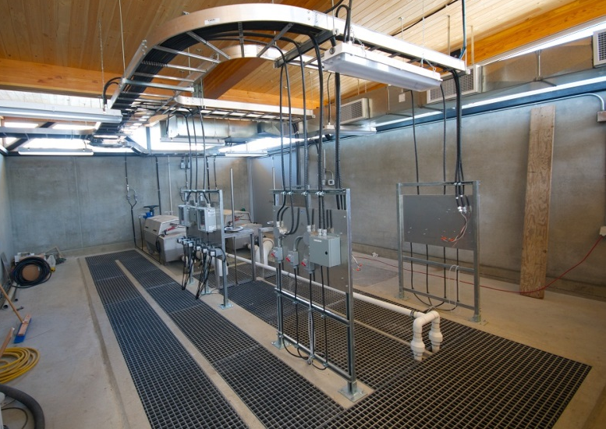
Project Profile
Senkulmen (Osoyoos Indian Band) WWTP, British Columbia
Project: Commercial Development
Start-up: 2012 (exp. 2015)
Size: 500 m³/d (130,000 GPD)
Process: USBF®
Contract: Design-Supply-Install
Key objectives:
  modular and expandable
  enhanced nitrogen reduction
  architecturally distinct
  solar power

Slide 14
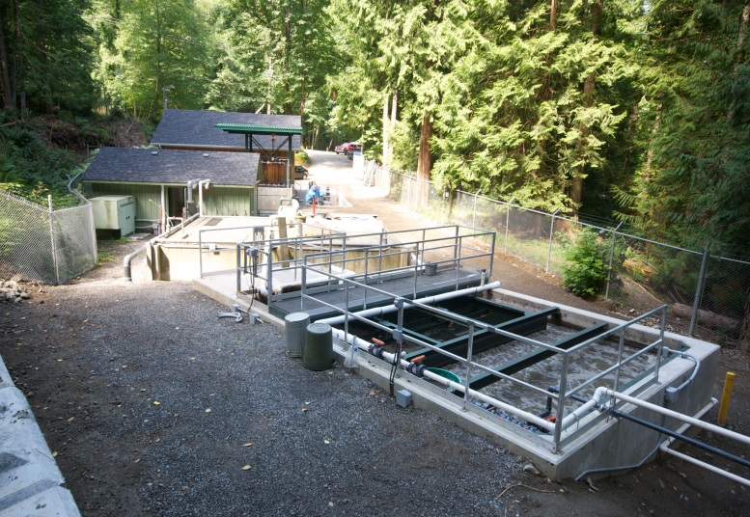
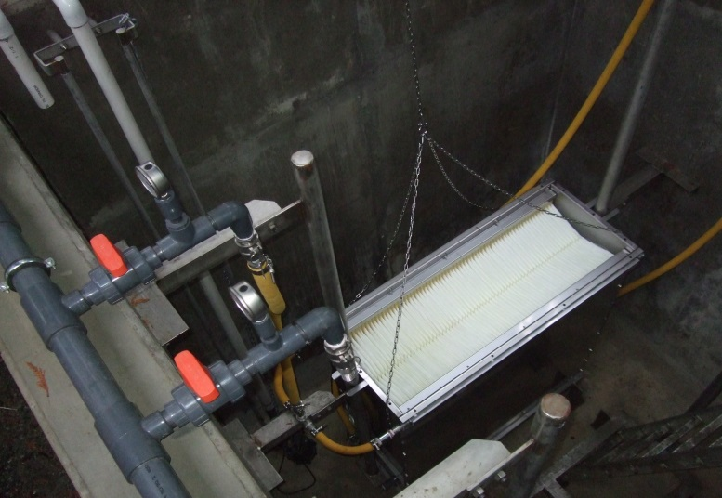
Project Profile
Snug Cove WWTP, British Columbia
Project: Municipality
Start-up: 1999 (exp. 2011)
Size: 240 m³/d (63,000 GPD)
Process: USBF® + membrane filtration
Contract: Design-Build-O&M
Key objectives:
  modular and expandable
  water reuse
  highly fluctuating flow and loading
  odor and noise abatement
  sludge dewatering
  septage receiving station

Slide 15
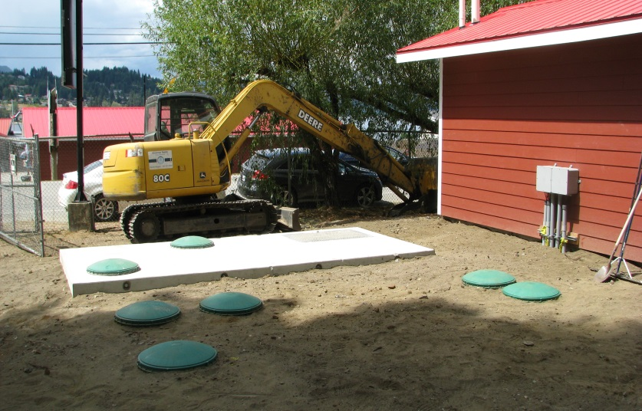
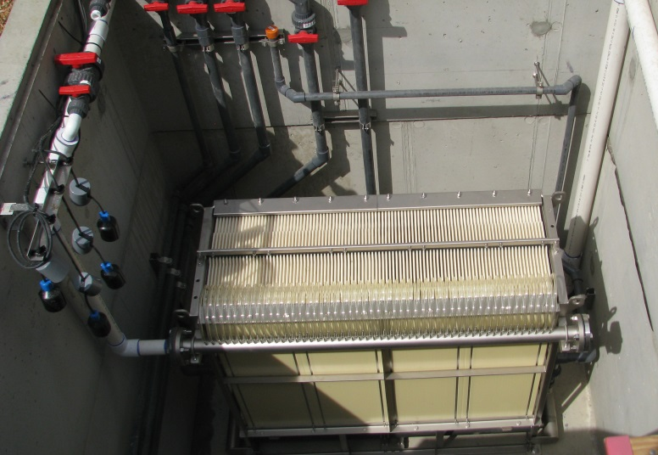
Project Profile
Finz Resort WWTP, British Columbia
Project: Restaurant and resort
Start-up: 2015
Size: 35 m³/d (10,000 GPD)
Process: MBR
Contract: Design-Supply
Key objectives:
  odor and noise abatement
  hidden
  high quality effluent
  highly fluctuating flows and loadings
  modular and expandable

Slide 16
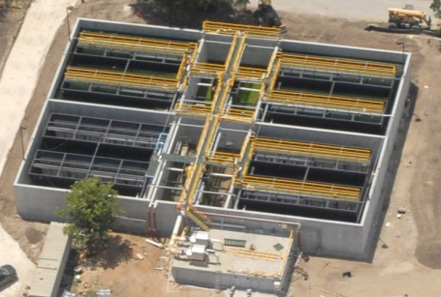
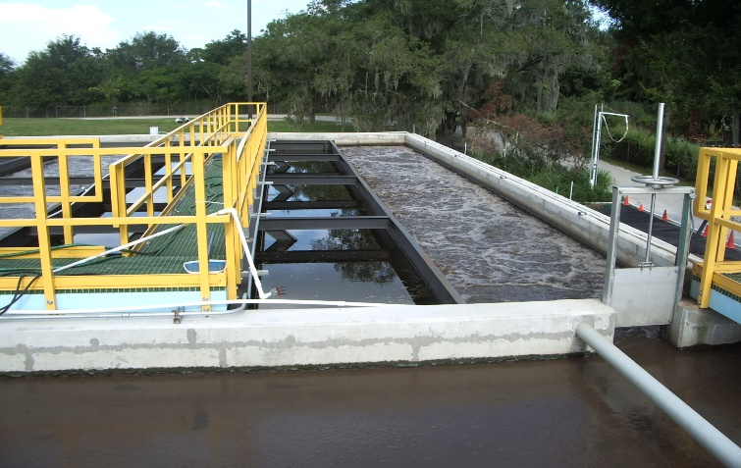
Project Profile
Lake Alfred, Florida
Project: Municipality
Start-up: 2006
Size: 4,000 m³/d (1 MGD)
Process: USBF
Key objectives:
  Modular
  Compact
  Retrofit
  Water reuse

Slide 17
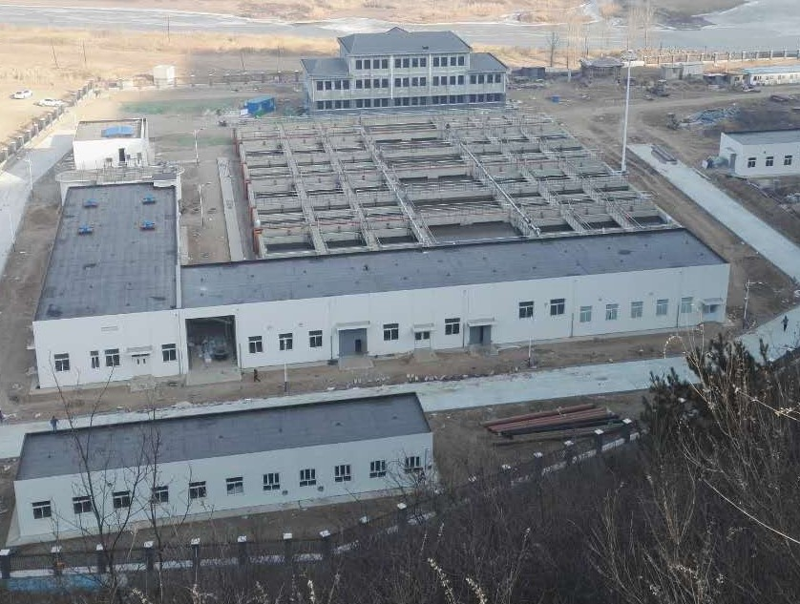
Project Profile
Chengde City, China
Project: Municipal
Start-up: 2015
Capacity: 15,000 m³/d (1.3 MGD)
Process: USBF
Key objectives:
  modular (3 bioreactor modules 5.000 m³/d each)
  compact
  phosphorus reduction
  low winter ambient temperatures
  concrete clarifier construction

Slide 18
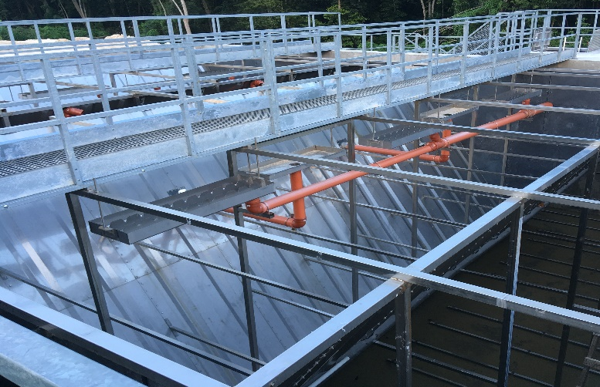
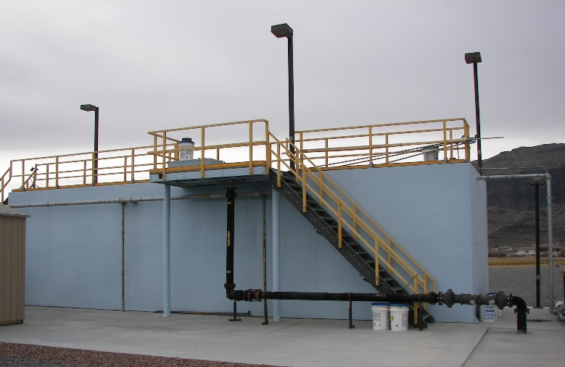
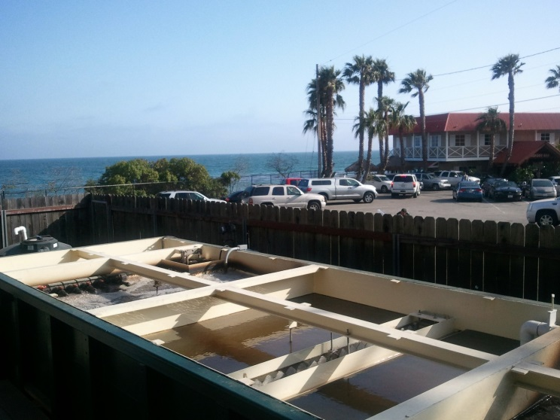
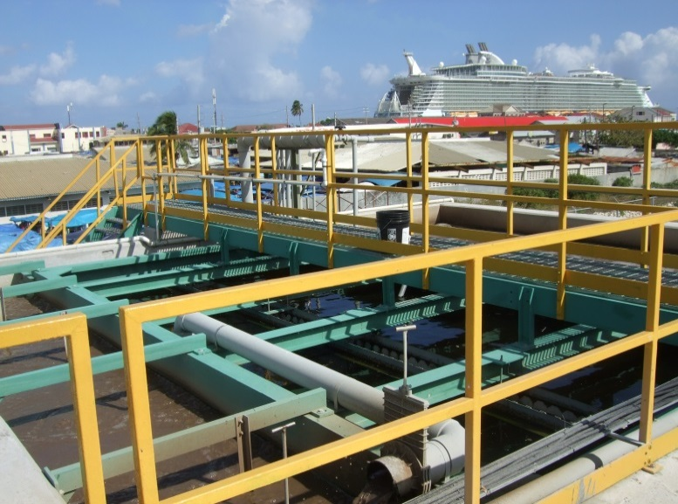
Other Projects
All stainless steel WWTP, Friendship, Jamaica
Pahrump WWTP, Nevada
Duke’s Malibu restaurant WWTP, California
Falmouth Port WWTP, Jamaica

Slide 19
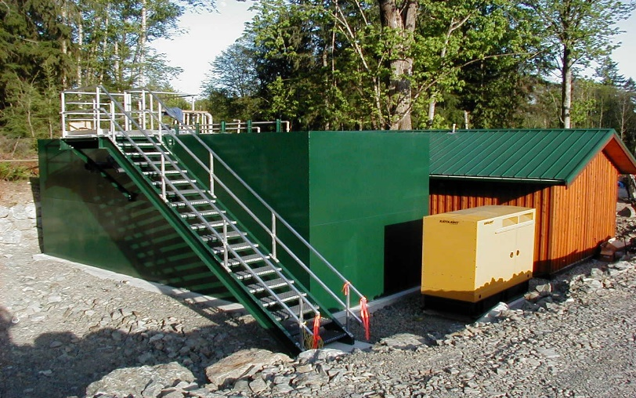
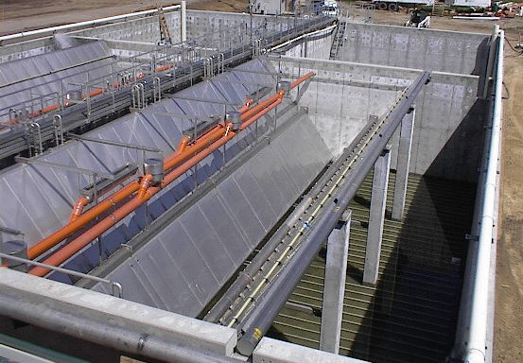
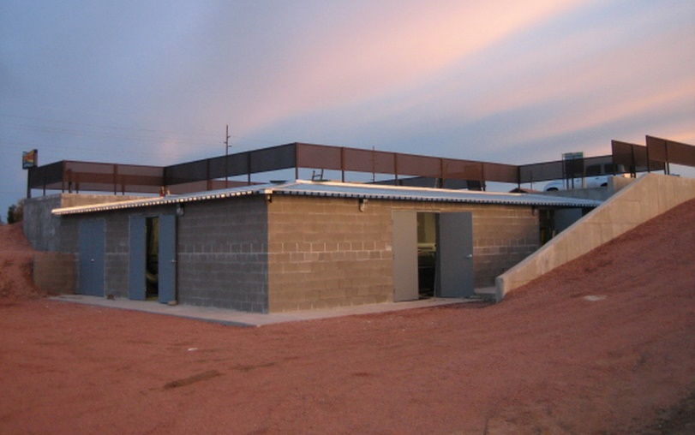
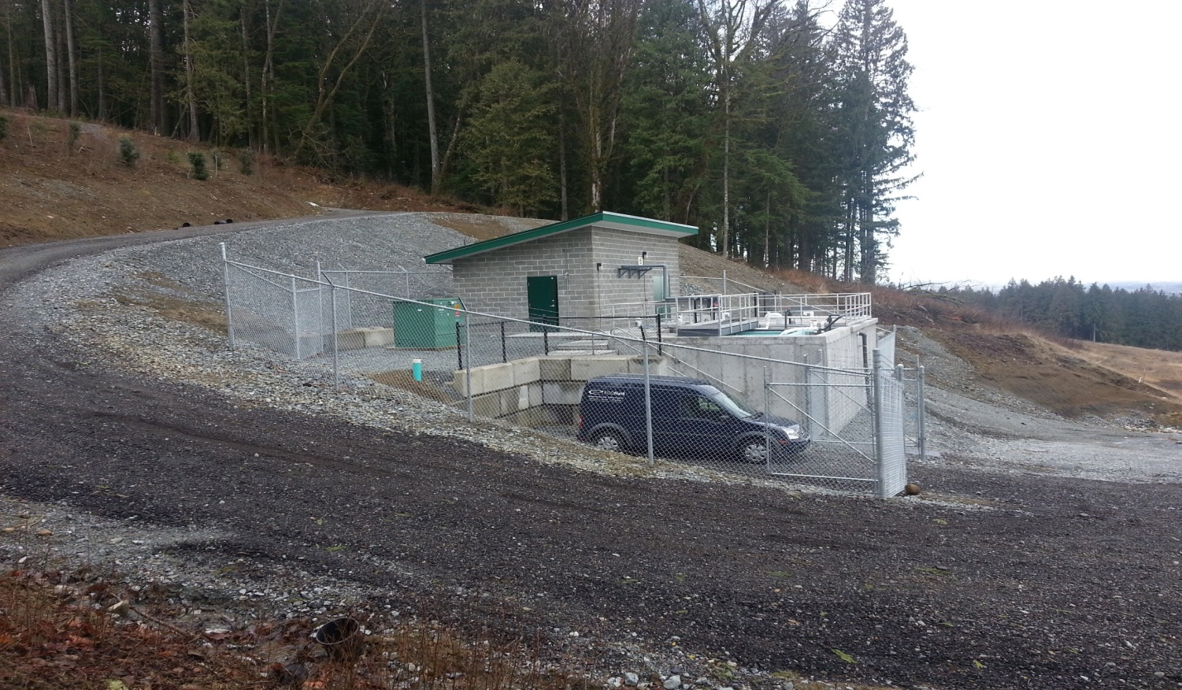
Other Projects
Cowan Point WWTP, British Columbia
Strathmore WWTP, Alberta
Tonto Apache WWTP, Payson, Arizona
Grant Hill WWTP, British Columbia

Slide 20
ECOfluid & NORAM Biosystems
Although ECOfluid and NORAM Biosystems have historically been two somewhat parallel teams, we are increasingly combining our complimentary skillsets/offerings when approaching clients.
E.g. Recent Combined Team Projects:
- Parkland Operations Support (Industrial)
- EWOS Cargill (Industrial)
Looking to grow our industrial and WW technology development client base over the next few years.

Slide 21
NORAM Biosystems Market Offerings
Technologies
- VERTREATTM Low Footprint
- MBBR-DAF Low cost sewer pre-treatment
- MBR (Sumitomo) Effluent Re-use
Services
Contract R&D on WW Technologies
Bench Testing/Process Validation (with BCRI)
Pilot Plant Design and Fabrication (with BCRI/Axton)
Temporary Treatment System Design/Procurement
Operations Sampling/Testing/Reporting (with ECOfluid)

Slide 22


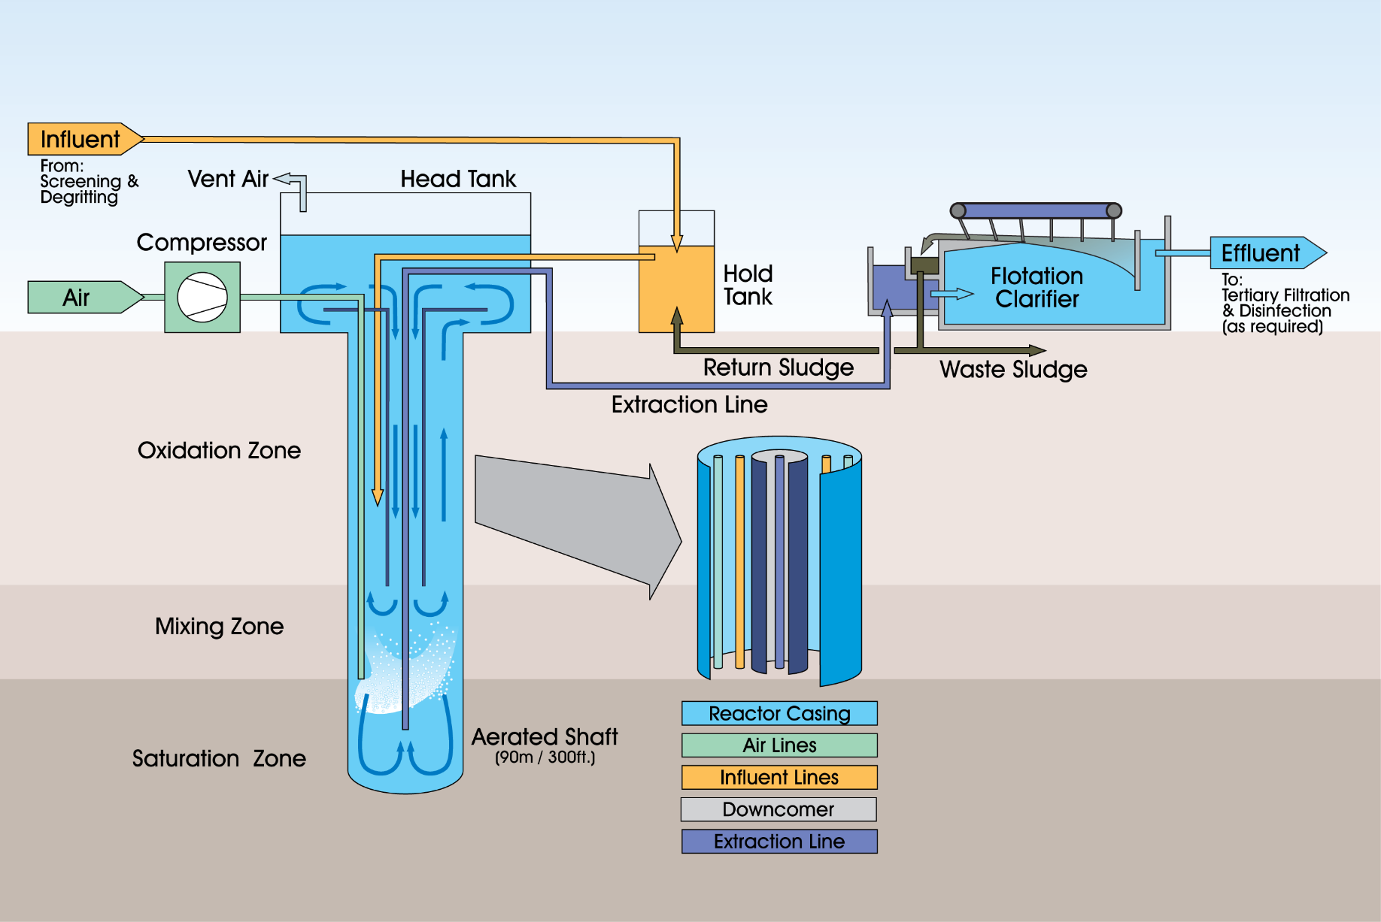
VERTREAT™ Process Features – Basic Flowsheet
Notes:
VERTREAT™ is a high-rate activated sludge process. A compact, high-pressure reactor replaces the large open aeration basin commonly found in activated sludge systems. Vigorous mixing and high oxygen transfer are critical design limitations in many conventional plants. The VERTREAT™ system has both intensive mixing and high oxygen transfers in a compact subsurface reactor, making it an efficient high-rate biological system that combines primary and secondary treatment in a single process.
The diameter of the reactor, nominally 2.5 ft to 20 ft, is determined by the quantity and strength of the material to be treated.
Three separate treatment zones:
The oxidation zone: mixed liquor circulates around a central concentric draft tube.
The mixing zone: is immediately below the oxidation zone. Air and influent are injected.
The polishing zone, or oxygen soak zone, occupies the bottom of the reactor.
Stage Description
①Aeration. Rising bubbles create a density gradient that results in airlift circulation
②Influent Injection. Untreated influent is introduced to the mixing zone
③Biodegradation. High OTE due to the pressure and depth - high DO and reaction rates.
④De-gassing. Spent off-gas bubbles vented to atmosphere.
⑤Polishing. High DO concentrations and HRTs destroy residual BOD in this zone. Dissolved gas saturation drives flotation solids separation in clarification.
⑥Withdrawal. Polished mixed liquor forced to the clarifier by hydrostatic pressure.
⑦Flotation. Rapid depressurization results in a well-aerated, low-density floc. NO Polymer!

Slide 23

VERTREAT™ Process Advantages
Low Footprint (as low as 20% of conventional AS)
  faster kinetics
  in-ground reactor volume
  flotation clarifiers
Low Energy Consumption (as low as 50% of conventional AS)
  Due to lower total aeration requirement
Low Odour
  Due to highly aerobic conditions at depth
Excellent BOD & TSS reduction
Low Ammonia and Total Nitrogen achievable with BNR flowsheet

Slide 24

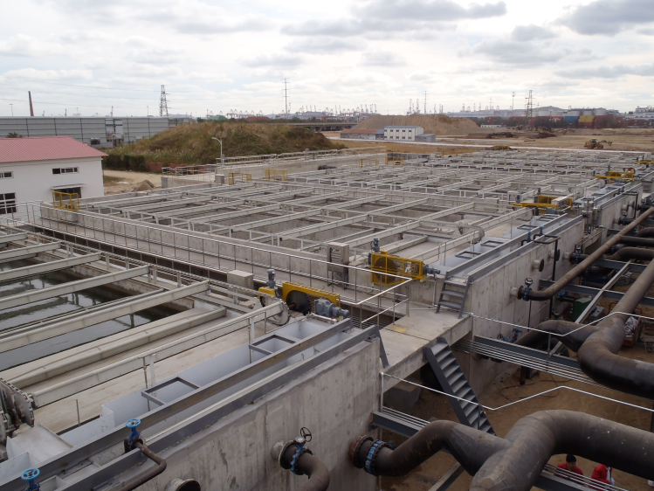
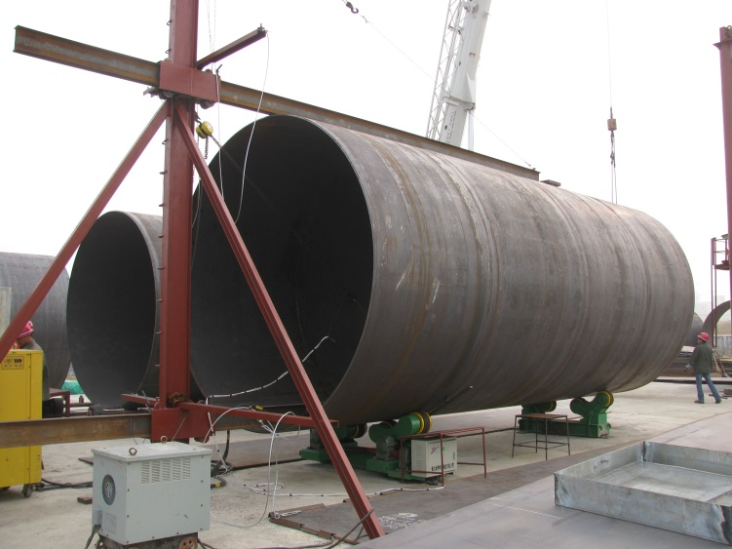
Qingdao, China
Commissioning Date: March 2012
System Design:
  3 Shafts - 3.2 meters in diameter by 92 meters deep
  40,000 m³/day (10.6 MGD)
  Carbon Loading -> 300 mg/L BOD₅, 400 mg/L TSS
  Nutrient Loading -> 45 mg/L TN, 35 mg/L NH₄-N, 8 mg/L TP
  180,000 PE
Effluent Standards:
  ≤ 10 mg/L BOD₅, ≤ 10 mg/L TSS, ≤ 15 mg/L TN, ≤ 5 mg/L NH₄-N, ≤ 0.5 mg/L TP (Class A Effluent)
Effluent Achieved:
  ≤ 5 mg/L BOD₅, ≤ 10 mg/L TSS, ≤ 7mg/L TN, ≤ 1 mg/L NH₄-N, ≤ 0.25 mg/L TP
Treats mixed domestic and petrochemical wastewater
Discharges to ecologically sensitive Yellow Sea

Slide 25
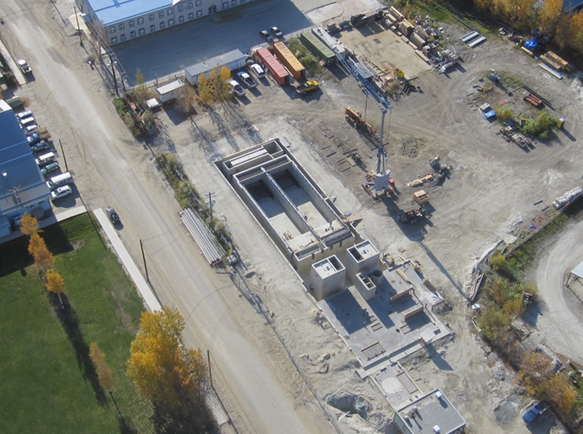
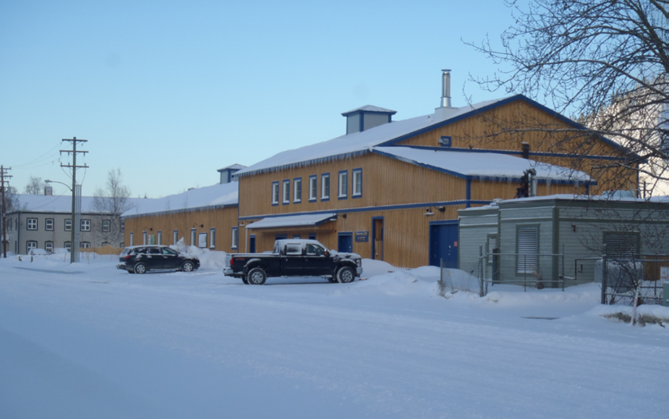
Dawson City, Canada
Commissioning Date: August, 2012
System Design:
  2 Shafts - 1 meter in diameter by 92 meters deep
  2,500 m³/day
  158 mg/L BOD₅, 105 mg/L TSS
  4,000 PE
Effluent Standards:
  ≤ 25 mg/L BOD₅, ≤ 25 mg/L TSS, 100% LC₅₀
Effluent Achieved:
  ≤ 10 mg/L BOD₅, ≤ 15 mg/L TSS, 100% LC₅₀
Completely enclosed design due to harsh winter conditions (designed for - 60°C)
Integrated heat recovery and biomass boiler to help offset energy requirements of the HVAC system
Discharges to Yukon River (international waterway)

Slide 26
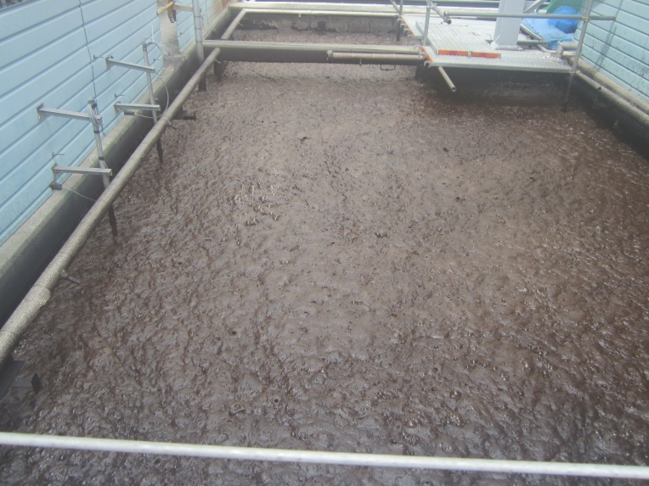
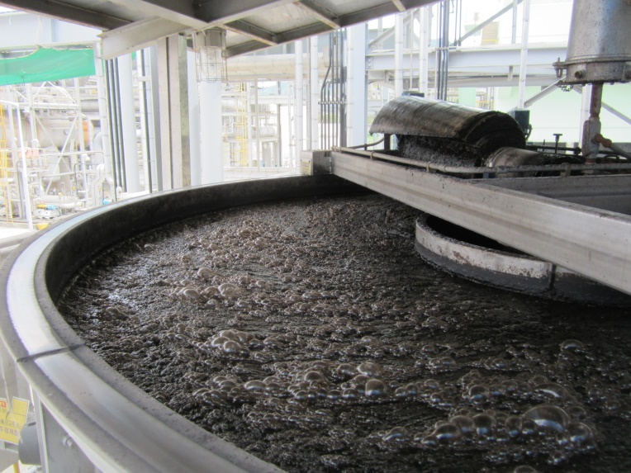
Huchems MNB, Korea
MBBR - DAF
Commissioning Date: August, 2009
System Design:
  TDZ - Buffer tanks – Denitrifying/Nitrifying MBBR - DAF
  528 m3/d
  2700 mg/L COD, 850 mg/L Total N
Effluent Standards:
  ≤ 300 mg/L BOD₅, ≤ 80 mg/L Total N
Effluent Achieved:
  ≤ 100 mg/L BOD₅, ≤ 50 mg/L Total N
Pre-treats MNB plant wastewater for discharge to municipal sanitary sewer
Laboratory pilot testing was undertaken to prove capability of selected design to meet required effluent quality

Slide 27

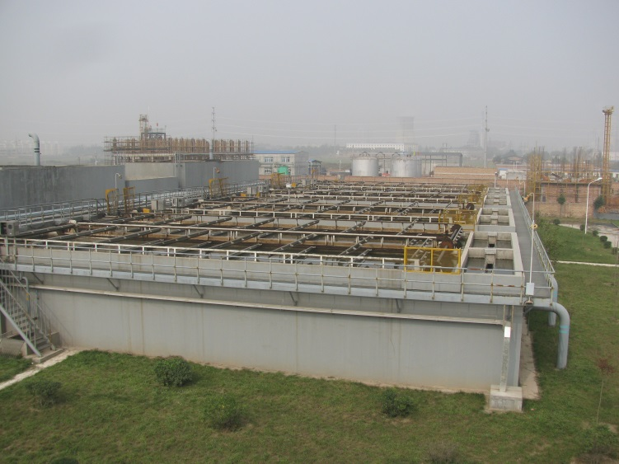
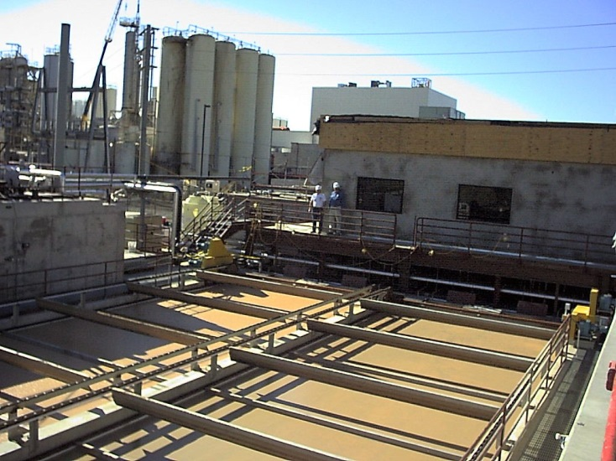
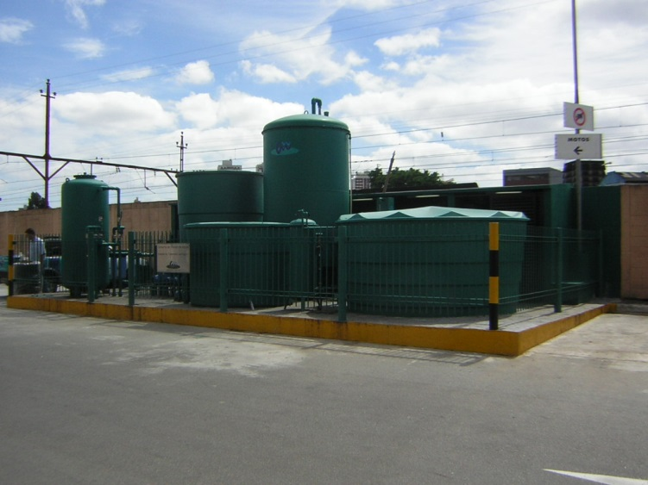
Other Projects
Parkland Refinery, Canada
Xingping, China
Golden Cheese, USA
ABC Shopping Mall, Brazil

Slide 28
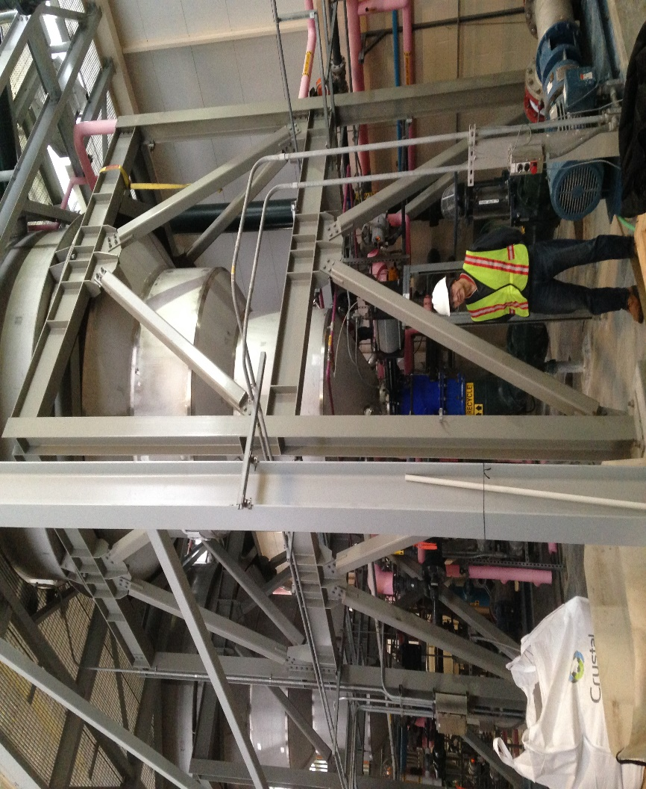
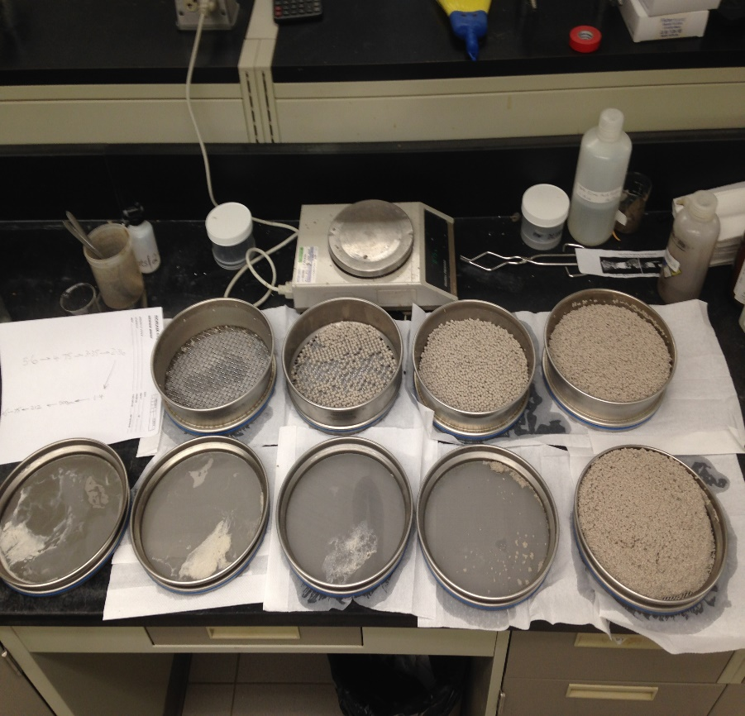
Contract R&D on WW Technologies
Struvite Crystallizer Process Optimization

Slide 29
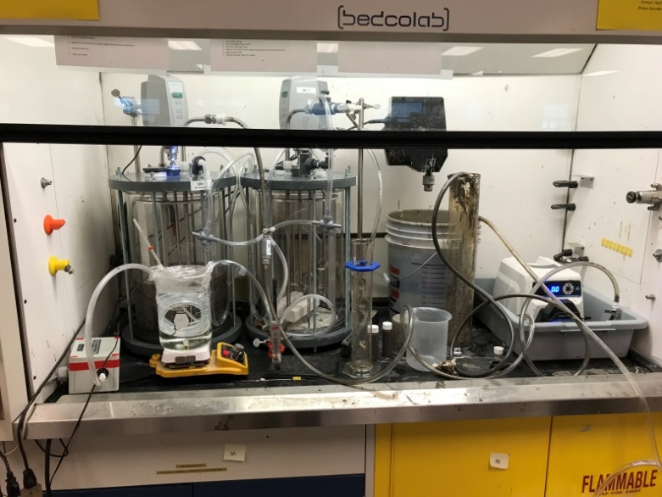
Bench Testing/Process Validation
Oil Sands Tailings Bench Testing at BCRI

Slide 30
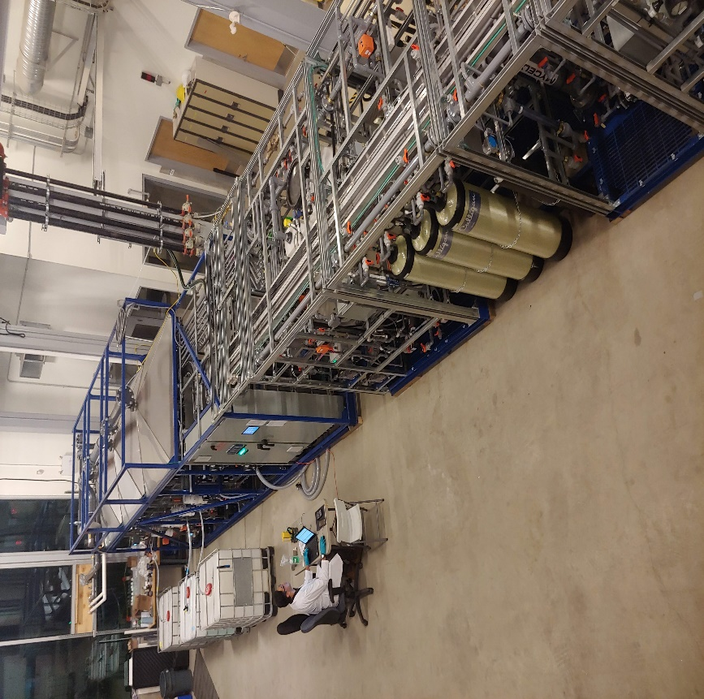
Pilot Plant Design and Fabrication
Oily Brine Salt Splitting Pilot Plant (with Electrochem group)

Slide 31
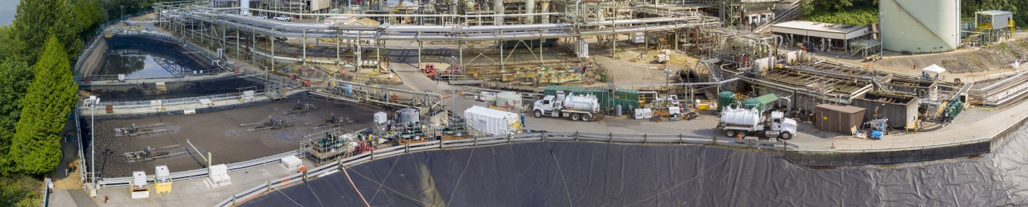
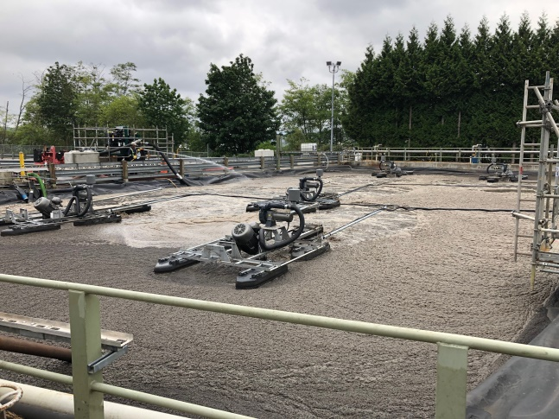
Temporary Treatment Systems
Full scale oil refinery temporary treatment system

Slide 32
MARKETING/SALES
DIRECT FLASH EMAILS
LINKEDIN – PLEASE PLEASE SHARE
WEB PAGE REVAMP
“SMALL FOOTPRINT – LARGE PERFORMANCE”
“ODOURLESS”, FEW MOVING PARTS, MODULAR, LOW NOISE
FACEBOOK ?
VIRTUAL “HEAD ON A SWIVEL”
FORWARD ANY SUGGESTION – kchicquen@ecofluid.com
ECOfluid Systems Inc.
Tel: (604) 662-4544
Email: info@ECOfluid.com

Slide 33
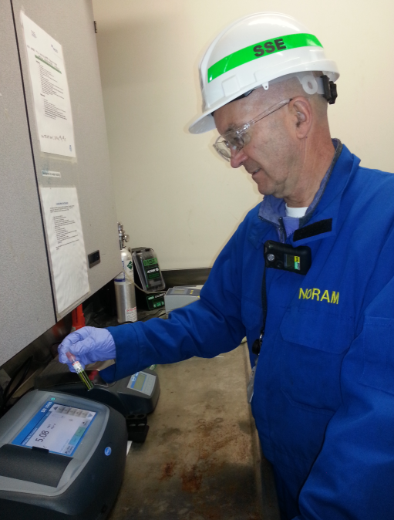
Thank You!
ECOfluid Systems Inc.
Tel: (604) 662-4544
Email: info@ECOfluid.com
ECOfluid operator performing lab analysis at industrial WWTP

